Slide 1
UFO Sightings

Slide 2
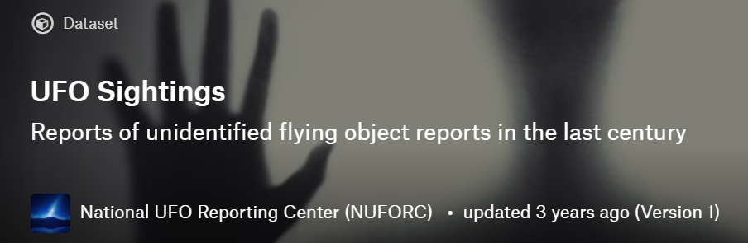
Dataset
This dataset contains 88679 reports of UFO sightings over the last century.
It includes the information of date, city, state, country, shape, duration, comments and coordinations of the sighting.

Slide 3
Sparsity
RangeIndex: 88679 entries, 0 to 88678
Data columns (total 11 columns):
datetime 88679 non-null object
city 88679 non-null object
state 81270 non-null object
country 76314 non-null object
shape 85757 non-null object
duration (seconds) 88677 non-null object
duration (hours/min) 85660 non-null object
comments 88644 non-null object
date posted 88679 non-null object
latitude 88679 non-null object
longitude 88679 non-null float64
dtypes: float64(1), object(10)

Slide 4
Preprocessing
Filling null entries in the dataframe to ease operations on the data
Removing bad lines
Regularizing city, country, state information
Splitting date into day/year/month formats
Filling the missing country information according to the city information

Slide 5
Questions
What areas of the countries are most likely to have UFO sightings?
Are there any trends in UFO sightings over time?
Do the sightings share common descriptions?

Slide 6
UFO Sightings by Location

Slide 7
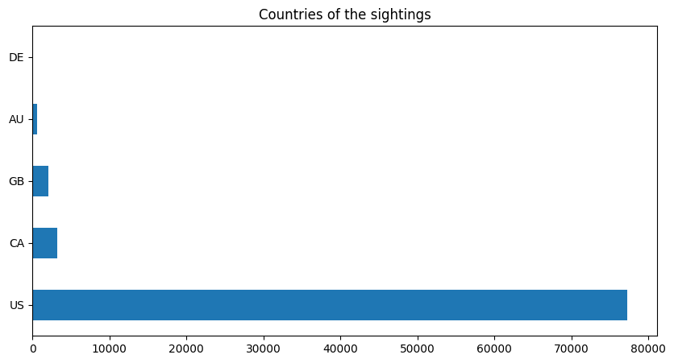
US Dominance
%87 of the sightings are reported from USA.

Slide 8
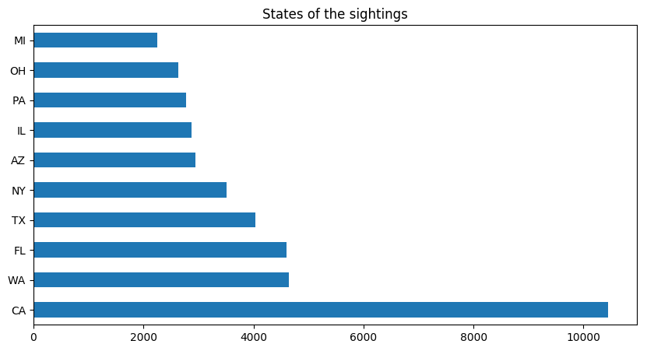
US States
Top 5 US states by population:
California
Texas
New York
Florida
Illinois

Slide 9
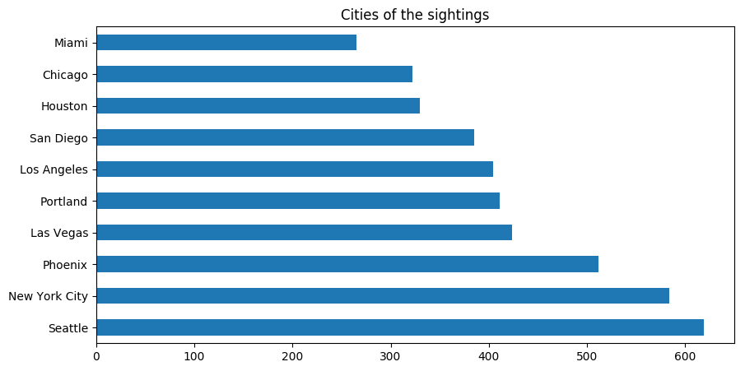
US Cities

Slide 10
UFO Sightings Over Time

Slide 11
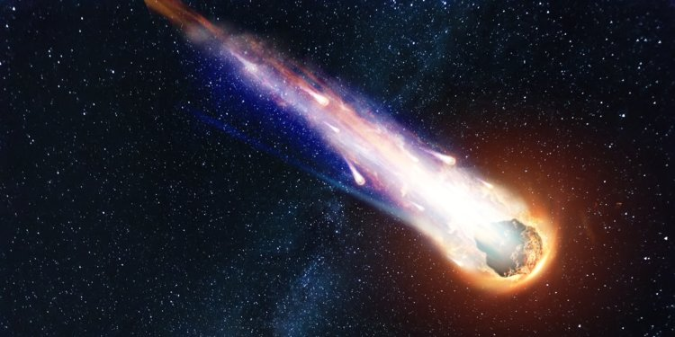
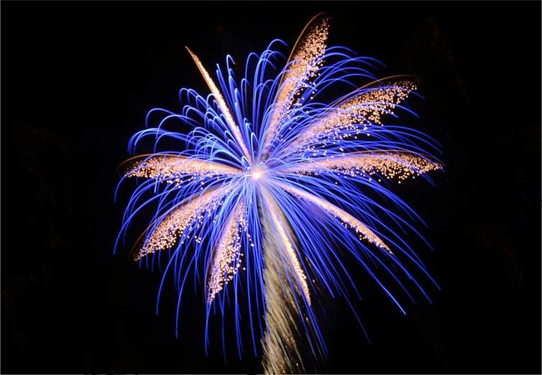
Popular Days
Some common days to see UFO’s:
4th of July - Independence Day
31 December, 1 January - New Year’s Day
30 June - International Asteroid Day

Slide 12
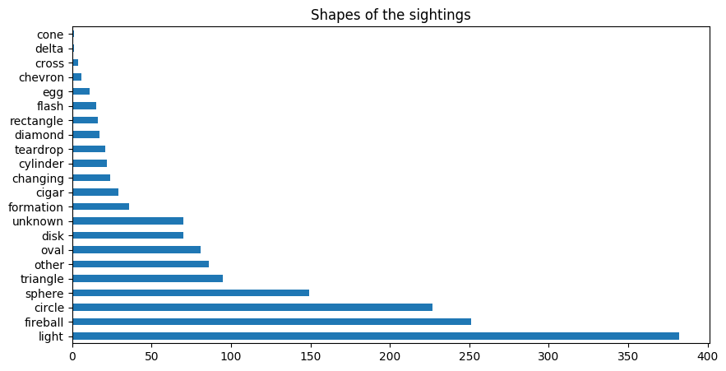
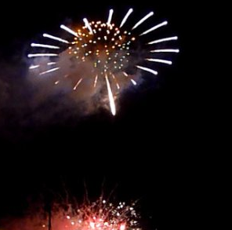
UFOs or not?

Slide 13
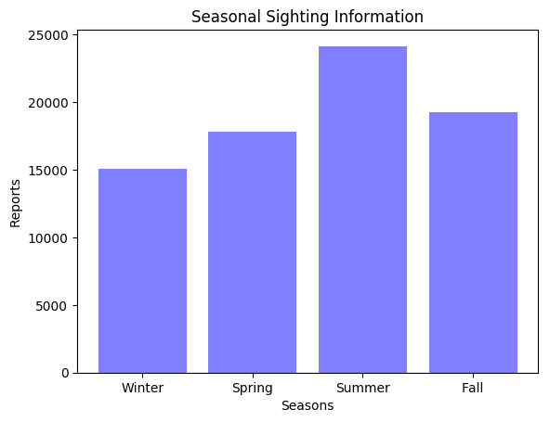
UFOs’ Favorite Season
People tend to spend less time outside during cold weathers.
The sky is not really clear enough to see anything during winter.

Slide 14
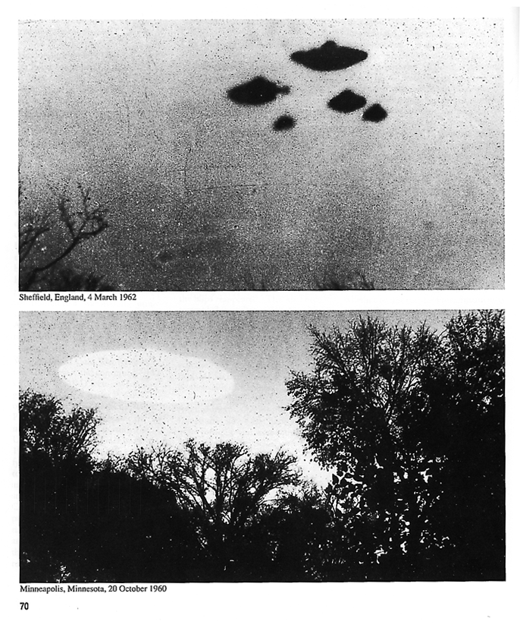
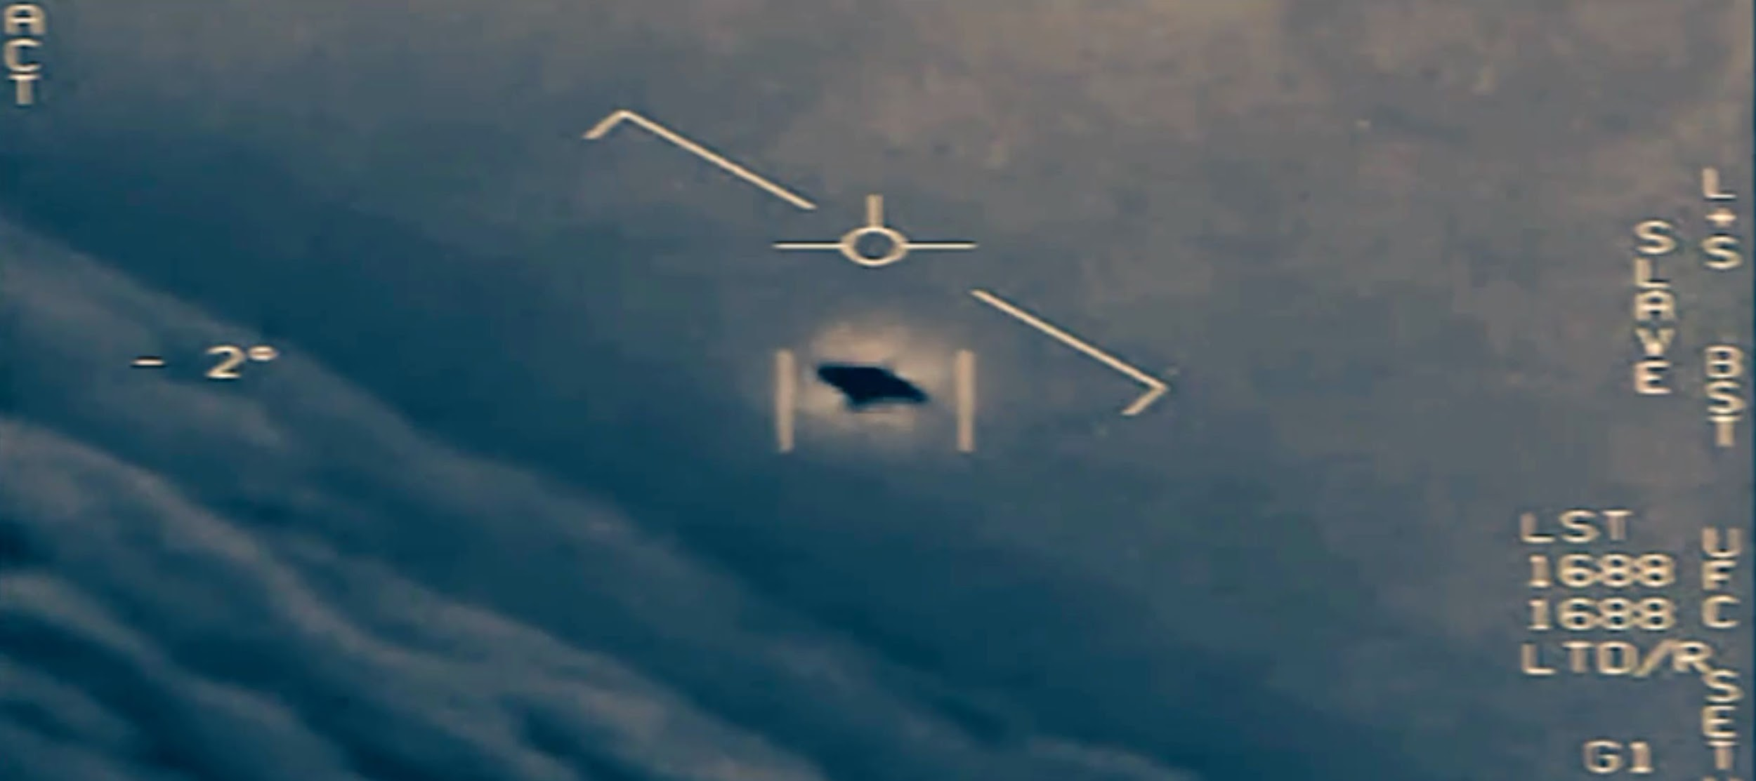
Sightings over years

Slide 15
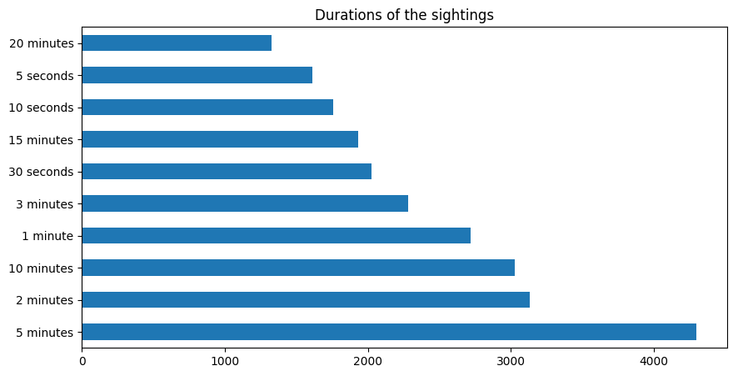
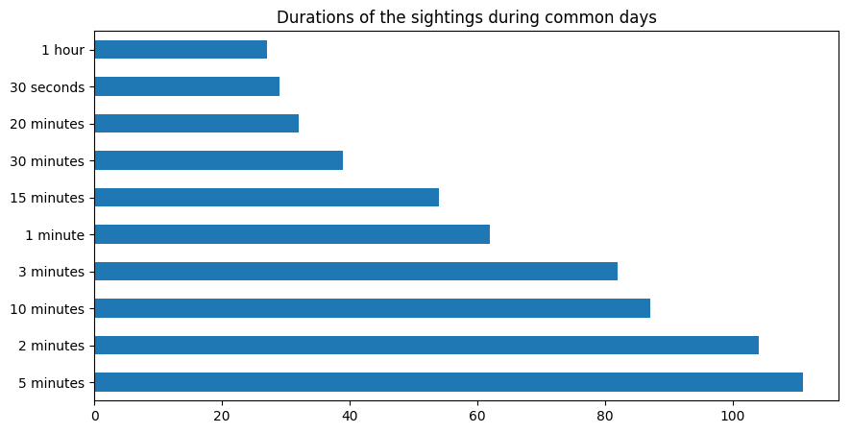
Durations

Slide 16
UFO Sightings by Descriptions

Slide 17
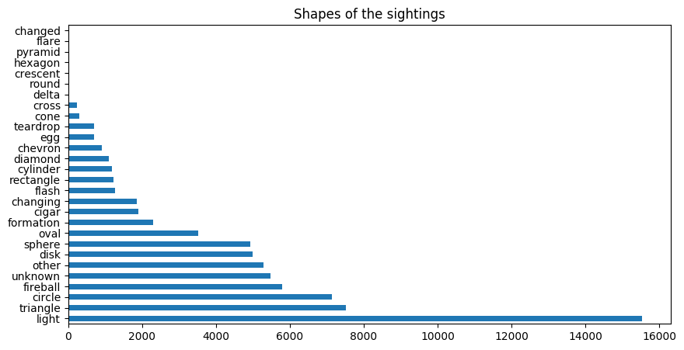
Our UFOs come in all shapes and sizes

Slide 18
Common Descriptions
People defined UFOs mostly as:
Orange, green, red by color
Bright/vivid, fast, floating, glowing, flashy, shiny
Weird, strange object

Slide 19

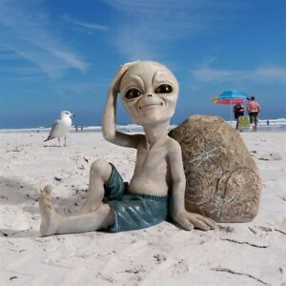
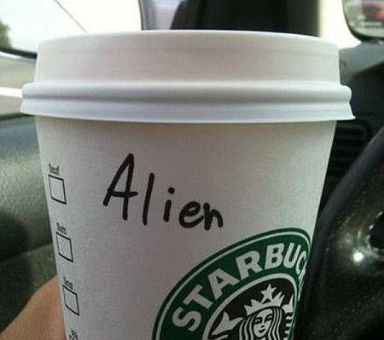
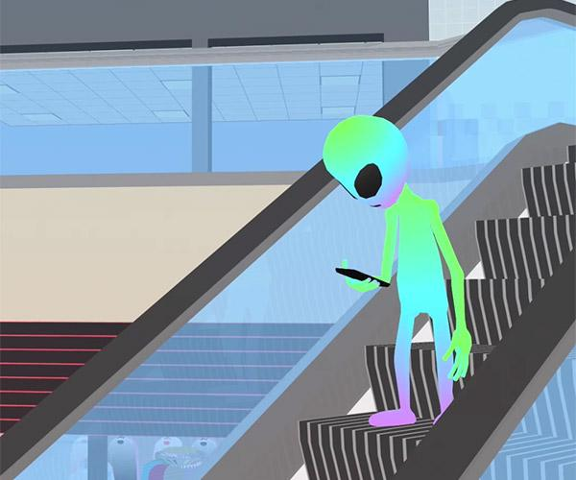
Conclusions
Aliens are American and tend to celebrate national US holidays.
Aliens are not really the biggest fans of winter.
Aliens are city people and love the crowd.

Slide 20
Thank You

